Slide 1
Presentation 10
Variable-Density Flow (VDF) Process in SEAWAT
Notes:
SEAWAT Training Course
Lecture 10

Slide 2
Variable-Density Flow (VDF) Process
Alternative to GWF Process
Uses modified and unmodified routines from GWF
Compatible with GLO, IMT and OBS
Not compatible with SEN or PES
Activated when ‘VDF’ included in name file

Slide 3
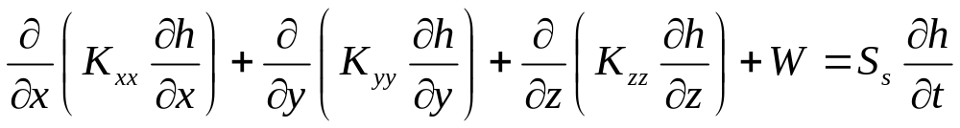
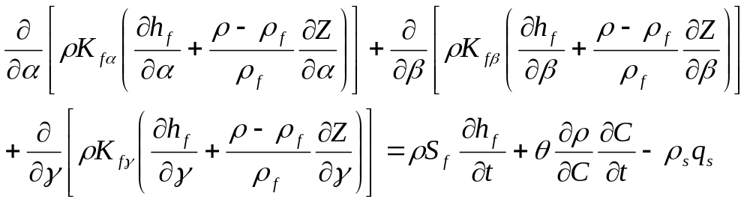
Groundwater Flow Equation
Constant density
Variable density
Limitation: assumes viscosity not affected by concentration

Slide 4
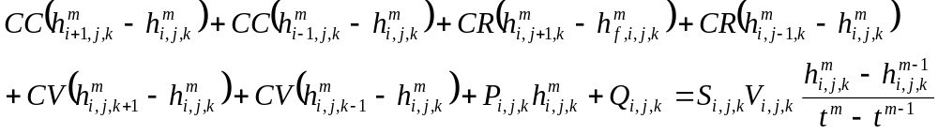
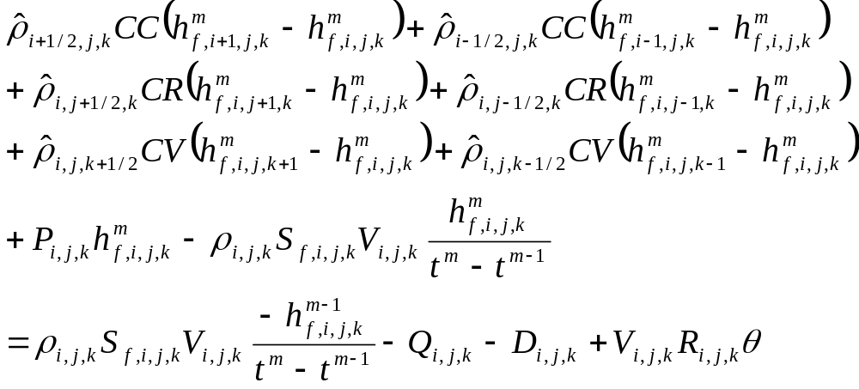
Finite-Difference Approximation
Constant density
Variable density

Slide 5
Required and Optional Flow-Related Packages
Basic Package (BAS6)
Internodal Conductance Packages
Time-Variant Constant-Head Package
Source-Term Packages
Solver Packages
Link-MT3DMS Package (LMT)

Slide 6
Basic Package (BAS6)
Required
Reads heads and IBOUND array
Initial heads read as h and converted to h_{f} for use in the flow equation
h_{f} converted to h before being written to output files

Slide 7
Internodal Conductance Packages (compatible with VDF)
At least one of the following three is required:
  Block-centered flow (BCF6)
  Layer-property flow (LPF)
  Hydrogeologic unit flow (HUF)
Horizontal flow barrier (HFB6)

Slide 8
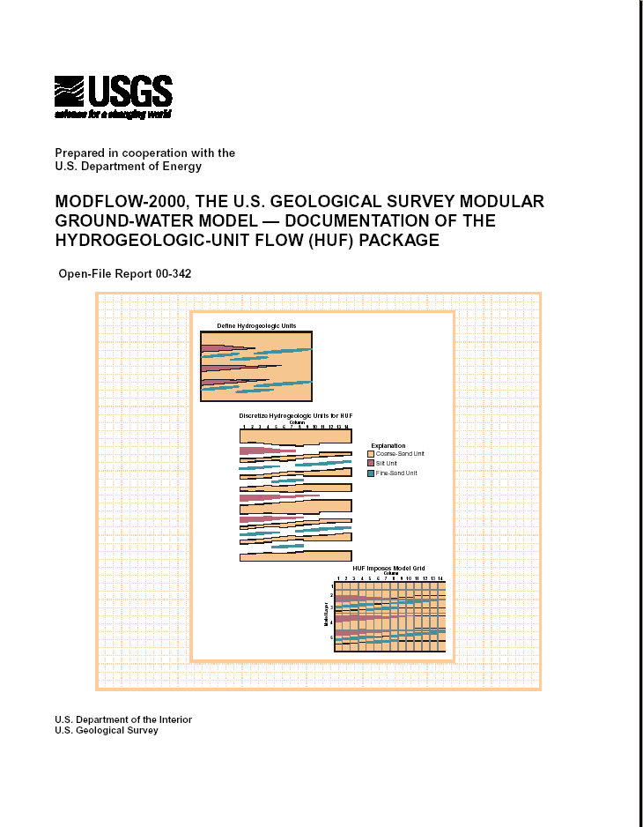
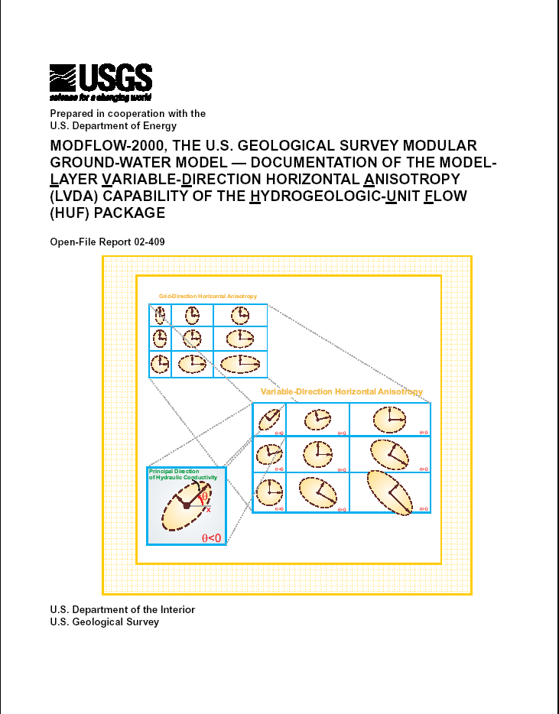
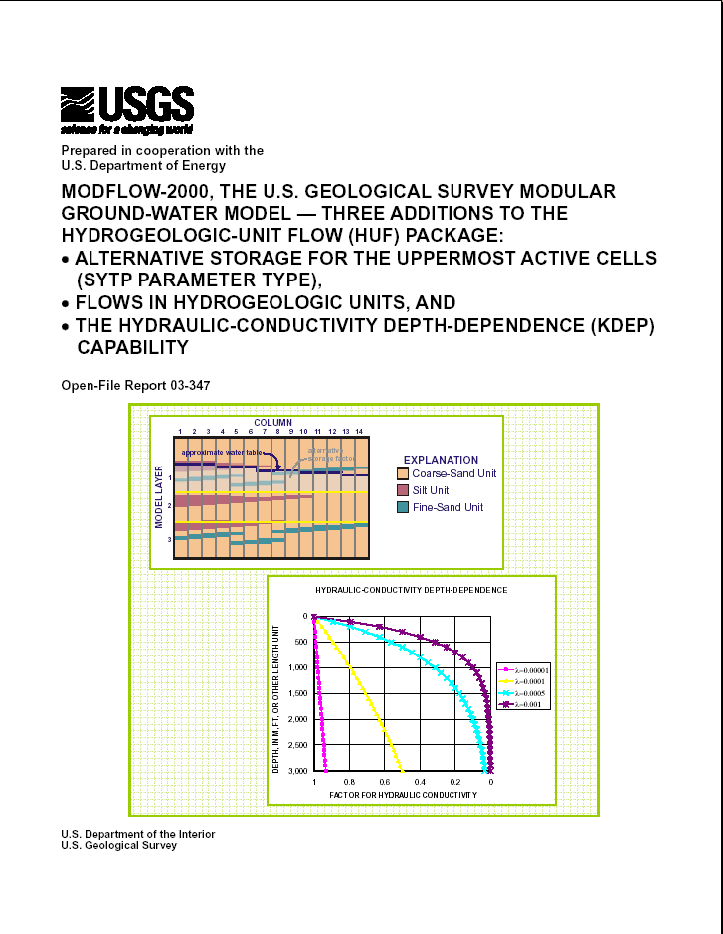
Considerations for HUF2
Works with VDF
Does not currently work
with VDF
Works with VDF

Slide 9
Modifications to Internodal Conductance Packages to Work with VDF
Relative density difference terms (come from variable-density form of Darcy’s Law)
Solute mass accumulation
Conserve mass
Use h instead of h_{f}
Vertical leakage to partially saturated cell
Variable-density flow for water-table case
Effects of viscosity variations can be included

Slide 10
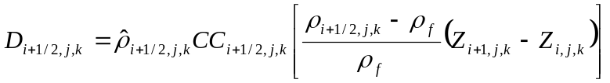
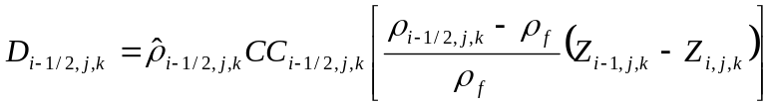
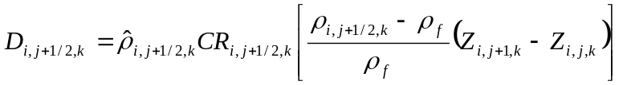
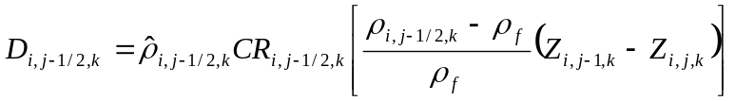
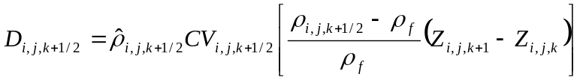
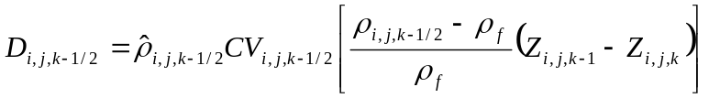
Relative Density Difference Terms
Primary effect of variable-density flow

Slide 11
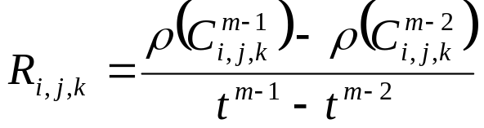
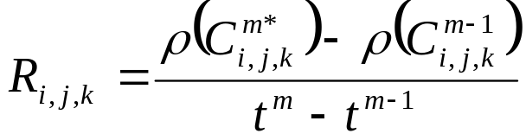
Solute Mass Accumulation
Explicit coupling between flow and transport
Implicit coupling between flow and transport

Slide 12
Conservation of Mass
All volumetric flow terms are multiplied by fluid density so that mass is conserved (rather than volume)
ρQ conserved not Q

Slide 13
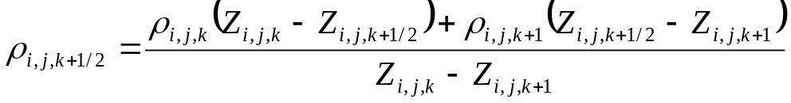
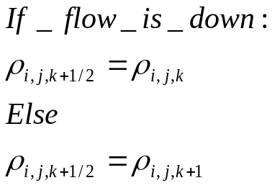
Weighting Schemes for ρ
Option 1—distance-weighted average
Option 2—upstream weighting
  Note: this option is only available for density terms used to conserve fluid mass. All other density terms calculated using distance-weighted average
eg.
i,j,k
i,j,k+1
eg.

Slide 14
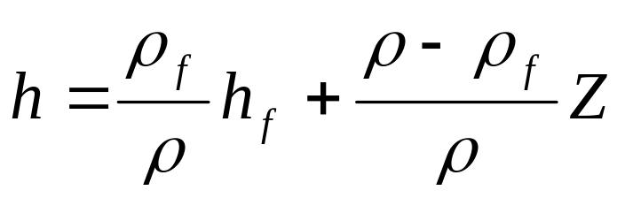
Use of h Instead of h_{f}
Calculation of conductances
Rewetting
Conversion between confined and unconfined
Evapotranspiration

Slide 15
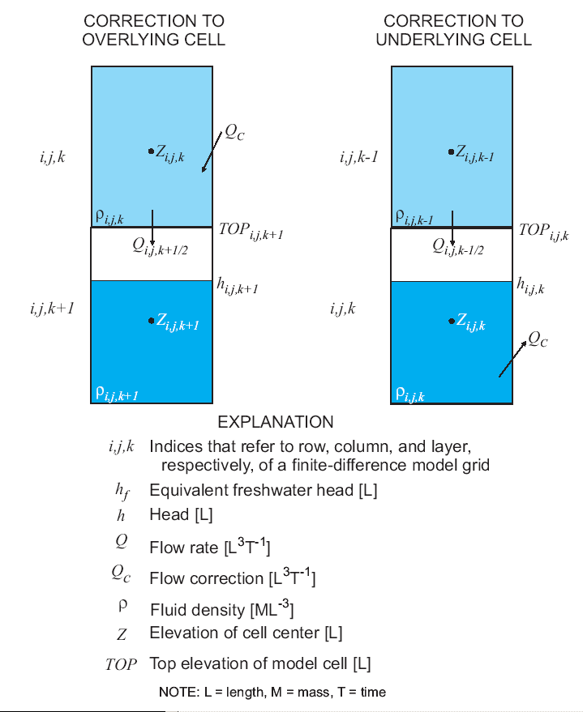
Leakage to Partially Saturated Cell

Slide 16
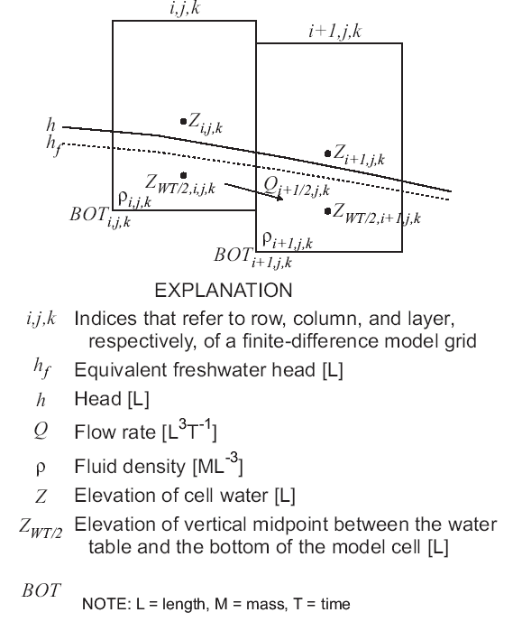
Water-Table Correction

Slide 17
Time-Variant Constant-Head Package
Constant heads read as h and converted to h_{f} for use in the flow equation
Works same as for constant-density MODFLOW simulations

Slide 18
Options for Specifying Constant Head Boundaries
Set in BAS6
  h_{f} calculated from h and starting concentrations. h_{f} held constant for simulation
  Can’t change h during simulation
Set in CHD Package
  h_{f} calculated from temporally interpolated h and simulated concentration
  Issue with MT3DMS boundary (ITYPE=1)

Slide 19
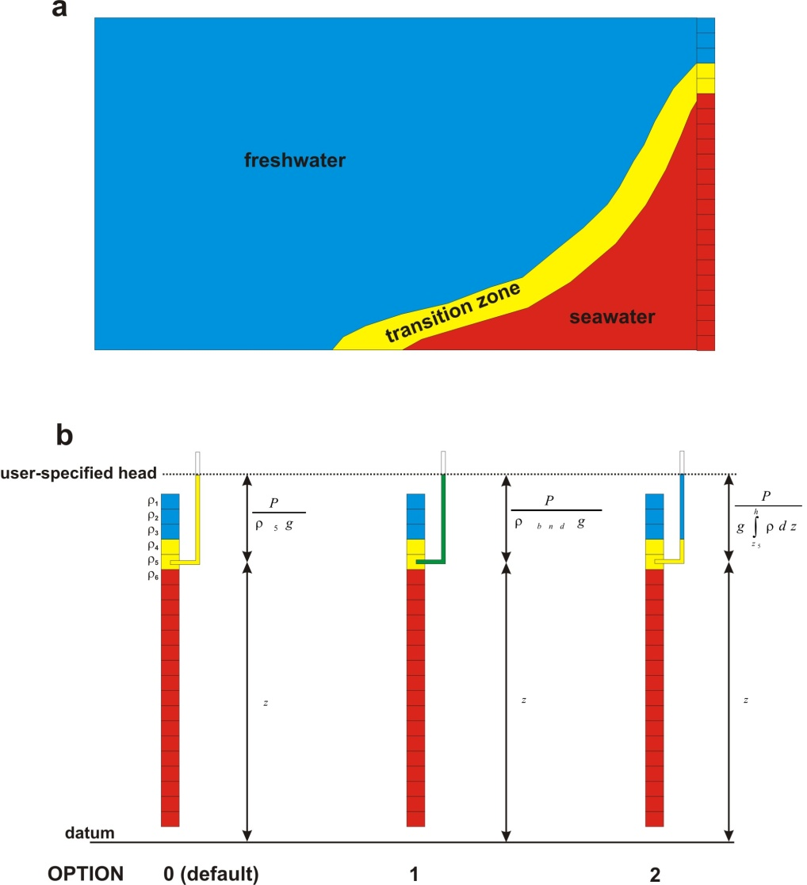
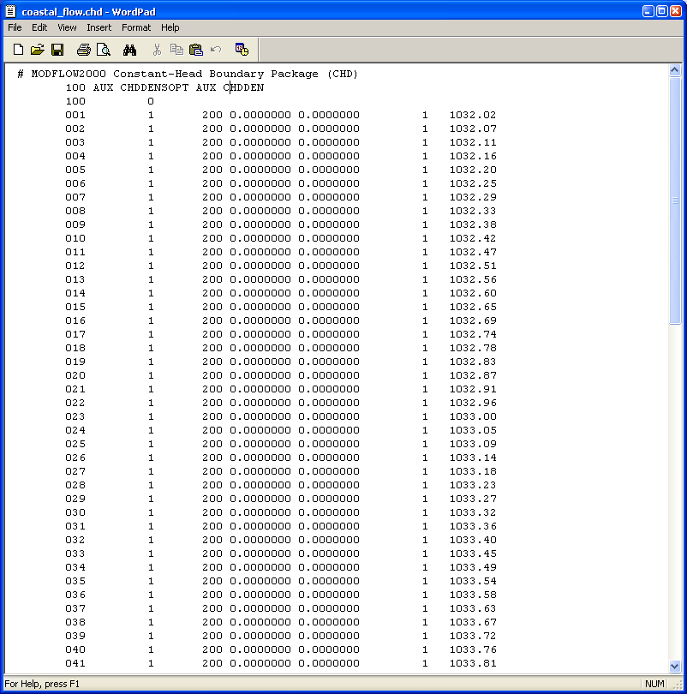
Options for CHD Boundaries

Slide 20
Source-Term Packages Compatible with VDF
Packages modified to use variable-density form of Darcy’s Law and to conserve fluid mass
  Well (WEL)
  Drain (DRN)
  River (RIV)
  General-head boundary (GHB)
  Recharge (RCH)
  Evapotranspiration (EVT)
  Drain with Return Flow (DRT)
  Segmented ET (ETS)
  Multi-Node Well (MNW)
  Flow and Head Boundary (FHB)

Slide 21
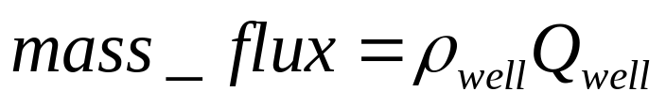



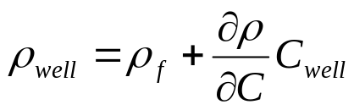
Well Package (WEL)
Injection
Default
Withdrawal
If specified by user through auxiliary variable
For coupled variable-density flow (if IMT is linked with VDF)

Slide 22
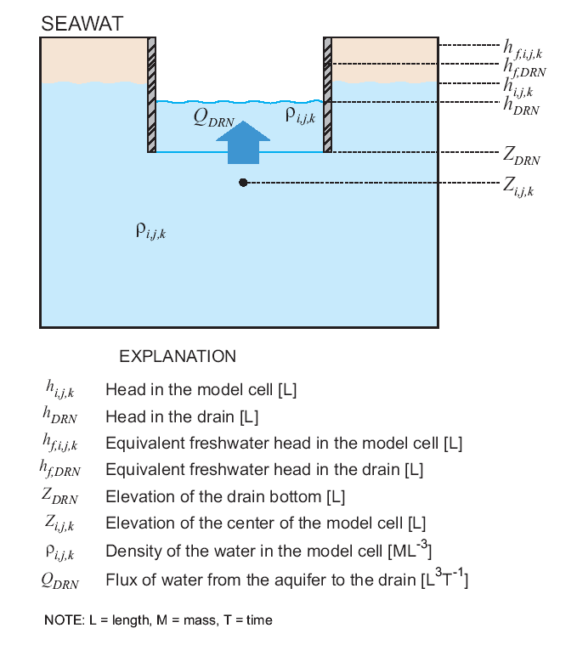
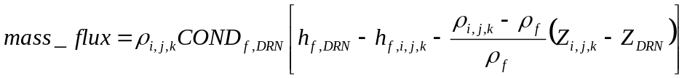
Drain Package (DRN)
Always density of model cell
Not included in standard MODFLOW input files
Users can specify using an auxiliary variable. If not, then Z_{DRN} set to Z_{i,j,k}

Slide 23
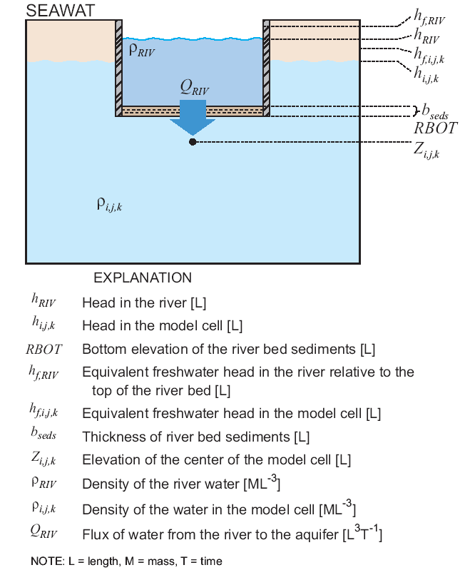




River Package (RIV)
Flow into river
Flow into aquifer
Not included in standard MODFLOW input files
Users can specify using an auxiliary variable. If not, then b_{seds} set to abs(Z_{i,j,k} –RBOT)

Slide 24
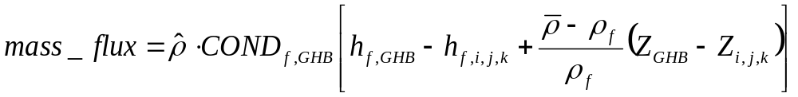


General-Head Boundary Package (GHB)
Flow into GHB
Flow into aquifer
Default
If specified by user through auxiliary variable
Not included in standard MODFLOW input files
Users can specify using an auxiliary variable. If not, then Z_{GHB}=Z_{i,j,k}
For coupled variable-density flow (if IMT is linked with VDF)

Slide 25
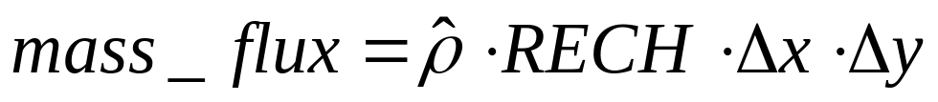

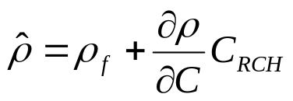

Recharge Package (RCH)
RECH > 0
Default
RECH < 0
For coupled variable-density flow (if IMT is linked with VDF)

Slide 26
Evapotranspiration Package (EVT)
ET equation reformulated to use head, instead of equivalent freshwater head
For the density term used to conserve mass:
  For coupled flow and transport, density calculated using concentration in source/sink mixing package
  Otherwise, density is set to reference density
Notes:
SEAWAT Training Course
Lecture 10

Slide 27
Solver Packages
No changes to solver packages themselves, but mass conductances are passed into solvers
Current solver packages:
  Strongly Implicit Procedure (SIP)
  Slice-Successive Overrelaxation (SOR)
  Preconditioned Conjugate-Gradient (PCG)
  Direct Solver (DE4)
  Algebraic Multi-Grid (LMG)
  Geometric Multi-Grid (GMG)

Slide 28
Link-MT3DMS (LMT) Package
Modified to use variable-density forms of flux calculations
Used internally in SEAWAT to pass flows from MODFLOW to MT3D
Can be used to save a flow-transport link file for subsequent MT3DMS simulations

